Slide 1
Principled (a.k.a. Problem-Solving, Win-Win) Negotiation
Phil Pfeiffer
Fall, 2014

Slide 2
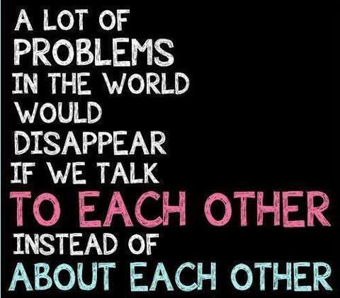
Negotation: Who Cares?

Slide 3
Negotation: Who Cares?
Politics = responsibility without authority
Negotiation = getting help with managing problems that one can't solve by oneself

Slide 4
Negotiation Archetypes
Positional bargaining (haggling)
▪ Simplest; most common
▪ Focuses on element of commitment
▪ Universally understood, frequently expected, concrete
▪ Disadvantages
▪ Difficult to maximize benefits for both parties
▪ Tends to be slow and inefficient
▪ Tends to arbitrary, "split-the-difference" outcomes
▪ Promotes adversarial relationships
▪ Best for following:
▪ simple, low stakes issues; low commitment to relationships
▪ situations where strong valuations limit range of outcomes
▪ bargaining done in fun
Source: Bruce Patton, Negotiation, in Moffit and Bordone, The Handbook of Dispute Resolution,

Slide 5
Negotiation Archetypes
Favors and ledgers
▪ Common in ongoing relationships
▪ Ubiquitous in legislative bodies
▪ Disadvantages
▪ Requires shared perception of value
▪ Repayment may not be possible,
due to shifts in participants
▪ Tends to arbitrary, "split-the-difference" outcomes
Chicken
▪ Typically unintended result of escalation of demands
▪ Highly risky (e.g., Lebanon)
Source: Bruce Patton, Negotiation, in Moffit and Bordone, The Handbook of Dispute Resolution,

Slide 6
Win-Win Negotiation: Essentials
▪ Prepare, prepare, prepare
▪ Identify interests - yours, theirs
▪ Brainstorm, then sift, options for increasing value
▪ Establish standards for dividing value
▪ replace "giving in" with "what's fair"
▪ Identify alternatives to negotiation
▪ identify Best Alternative To Negotiated Agreement (BATNA) - yours, theirs
▪ boost your BATNA
▪ decide if negotiation worth it, based on BATNAs
▪ Draft proposals - ideal, reasonable, just enough
▪ Rehearse before negotiating
Source: Ury, Getting Past No; essentially, a synopsis of Fisher and Ury, Getting to Yes

Slide 7
Difficult Negotiations: Essentials
Try to maneuver other party towards win-win
▪ "Go to the balcony"
▪ When provoked/ blindsided,
pause, identify tactics, think, act carefully
▪ "Step to their side"
▪ Actively show respect for other party
▪ "Reframe"
▪ Focus on changing context of negotiation
▪ "Build a golden bridge"
▪ Find strategies for advancing other party's interests
▪ "Use power to educate"
▪ Inform, don't threaten; use cost-benefit, BATNAs
Source: Ury, Getting Past No; essentially, a synopsis of Fisher and Ury, Getting to Yes

Slide 8
Bad Faith Negotiation: Tactics
▪ Stonewalling - i.e., refusing to budge
▪ Attacks - i.e., intimidation
▪ Tricks - e.g., lies, social engineering
▪ Googling "negotiating tricks" yields 4M+ results: e.g.,
▪ Vandra Huber http://faculty.washington.edu/vandra/html/body_negdirty.html
▪ Real Estate Investing Adventures http://myactualprofits.com/wordpress/2008/05/16/negotiation- tactics-and-tricks/

Slide 9
Selected Tricks
Imposing preconditions on outcome
as condition for (further) negotiating
Distorting standards of value
▪ Unreasonable 1st offer
▪ Using false "data"
▪ False BATNA (e.g., fictional "other buyer")
Obscuring value
▪ Treating key issue as insignificant
▪ Deliberately complicating deal
Stonewalling negotiations
▪ "Take it or leave it"
▪ "You'll have to do better"
▪ Chicken (bluff + threat)

Slide 10
Selected Tricks
▪ Rushing negotiations
▪ e.g.: false time limit; threatening to withdrawing offer
▪ Leveraging false "fairness"
▪ e.g.: big favor, little favor; splitting the difference
▪ Hostility
▪ e.g.: personal attacks; intimidation; threats
Leveraging "plausible" denial
▪ Good cop / bad cop
▪ Claiming lack of authority after negotiations start
"Accepting" deal in bad faith
▪ Asking for add-ons
▪ Reneging under false pretenses to get more concessions

Slide 11
Addressing Bad-Faith Negotiation
Speak when you are angry and you will make the best speech you will ever regret.
-- Ambrose Bierce (quoted in Ury, ibid.)
Taking offense is as violent as giving offense.
-- Michael Beckwith (quoted by Blum,
Little Book of Runic Wisdom)

Slide 12
Addressing Bad-Faith Negotiation
Avoid quick reaction
▪ striking back
▪ giving in
▪ breaking off
Instead, slow the pace
▪ pause and say nothing, and/or
▪ review what just happened, and/or
▪ ask for a time-out

Slide 13
Show Respect
For the other party
▪ Listen actively
▪ Paraphrase, asking clarifying questions
▪ Acknowledge other party's points, feelings
▪ Apologize, when appropriate
▪ Agree where you can - without conceding
▪ Acknowledge the person's competencies
▪ Be careful of "but", "you" - use "and", "I" instead
For yourself
▪ Project confidence
▪ Stand up for yourself

Slide 14
Reframing and Question-Asking
▪ Use value-neutral, open-ended questions to help turn negotiation into an exercise in problem-solving
▪ What are we trying to accomplish here?
▪ How would you like me to proceed?
▪ What is it that brought us into this situation?
▪ How can we solve the problem?
▪ What's the objective?
▪ How am I supposed to accept this?
▪ Note emphasis on "how" questions
▪ Be careful of "why" questions?
▪ Be silent after asking, if need be - - wait for answers
Questions from Schonwille, Manion, "The Secret of Gaining the Upper Hand is to Give the Other Side the Illusion of Control", http://www.acbmediation.nl/The%20secret%20of%20gaining%20the%20upper%20hand%20Q&A.pdf

Slide 15
Managing Problems in Reframing
Go around stone walls
▪ Ignore
▪ Reinterpret as aspiration
▪ Test the stone wall (e.g., threatened action)
Deflect attacks
▪ Ignore
▪ Reframe as
▪ friendly action
▪ attack on problem
▪ call for joint action
Expose tricks
▪ Ask for clarification
▪ Make reasonable request
▪ Turn tricks to advantage (e.g., bad professions of good faith)
When necessary, negotiate about the negotiations

Slide 16
Playing to the Other Party
Ask for, build on their ideas
Ask for constructive criticism
Offer choices
Satisfy unmet interests, incl. "irrational" human needs
Help other party save face - e.g., using "fairness"
Help other party find reasons to declare victory
Negotiate gradually
▪ Go step-by-step
▪ Delay asking for final commitment until end
▪ Allow time to be comfortable

Slide 17
The most powerful word in business negotiations is: fair.
▪ You will comply with the agreement if you feel you have been treated fairly.
▪ You will choose not to comply if you feel not treated fairly.
If you use the word fair in a negotiation, call that the f-word, people will begin to respond emotionally. Emotions play a role that cannot be ignored in business negotiations.
-- Charles Voss, cited by Schonwille (ibid.)

Slide 18
Educating the Other Party
Ask reality-testing questions: e.g.,
▪ What will happen if we don't agree?
▪ What do you think I will do?
▪ What will you do?
Don't threaten - inform
▪ Demonstrate your BATNA
▪ If necessary, deploy BATNA,
using minimum force and legitimate means
Even when you can win, negotiate

Slide 19
Forge Lasting Agreements
Design deal to minimize risks
Build in dispute resolution procedures

Slide 20
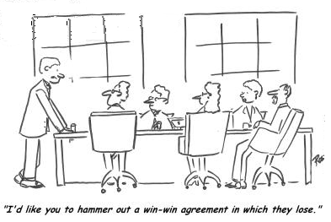
Critiques of Win-Win

Slide 21
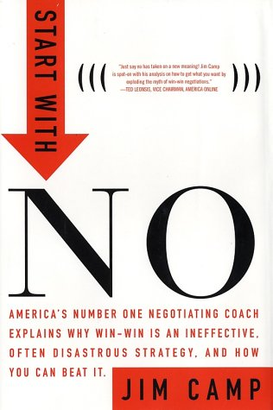
Jack Camp: "Start with No"
A "typical" critique of win-win
Many ideas comparable to Ury's: i.e.,
▪ Notes that "win-win" negotations, taken to end, often don't conclude in wins
▪ Emphasizes focusing on process first, successful conclusions second
Voss: a "straw man" argument / marketing ploy

Slide 22
Critiques of Win-Win (Patton)
Critique: glosses over realities of distributive negotiations
▪ Counter:
▪ Pure adversarial relationships don't exist in truth
▪ Distributive negotiations need not be adversarial
▪ Problem-solving:
a constructive approach to managing distribution
Critique: only works if both parties play win-win
▪ Counter:
▪ True of any approach to negotiation
▪ Practices are best practices,
regardless of other party is focused on win-win
▪ Emphasis on legitimacy tends to succeed,
if opponent not a sociopath

Slide 23
Critiques of Win-Win (Patton)
Critique: sometimes the person is the problem
▪ Counter:
▪ Circumstances that favor the alternative - - intimidation - -
are uncommon
▪ Inherent difficulty in negotiation, anyway
Critique: sounds simpler than it really is
▪ This is true (Patton)
▪ Three inherent tensions (Mnookin, Bargaining with the Devil):
▪ Balancing what's going on across the table, behind the table
▪ Balancing pragmatism and principle
(i.e., the desire to be effective vs. the desire to punish wrong)
▪ Balancing empathy and assertiveness
▪ Ability to remain respectful in face of strong disagreement "requires a level of maturity and cognitive development greater than most people possess".

Slide 24
Critiques of Win-Win
Slogans like "win-win", often associated with my Harvard program, are incomplete and misleading. They make it all sound too easy. I believe that effective conflict resolution requires one to manage certain tensions that cannot fully be resolved. People can learn to manage these tensions, but it is hard work. It takes motivation, especially in the context of a large institution.
-- Robert Mnookin, Barganing with the Devil

Slide 25
Bargaining with the Devil
Book by Robert Mnookin, Harvard Negotiating Project, on negotiating with evil people
▪ Evil person:
[one who, by] disposition … repeatedly commits evil acts.
▪ Evil action:
An act is evil when it involves
the intentional infliction of grievous harm
on another human being
in circumstances
where there is no adequate justification.

Slide 26
Negotiation vs. Confrontation/ Avoidance
Hostilities arise in different contexts
▪ Among relatives
▪ Mnookin: case analysis of divorce, sibling conflicts
▪ Among businesses
▪ Mnookin: case analysis of IBM vs. Fujitsu
▪ Within cultures
▪ Mnookin: case analysis of Mandela and So. Africa
▪ Among nations
▪ Mnookin: case analysis of Churchill and Nazis
All strategies for resolving disputes have potential costs and benefits

Slide 27
Mnookin's Decision Points
What are my interests? my adversary's interests?
▪ You may have to force yourself to consider latter
What are my alternatives to negotiation? my adversary's?
▪ Better BATNA ➔ more power at bargaining table
Do any potential negotiated outcomes beat BATNAs?
What are expected costs of negotiation?
▪ Transactions: time, money, manpower, resources
▪ Spillover: e.g., reputation
If a deal is struck, will it be implemented?

Slide 28
Mnookin's Traps
Unduly promoting refusal
Tribalism
Demonization
Dehumanization
Moralizing, self-righteousness
Zero-sum fallacy
Fight/flight reaction
Call to battle
Unduly promoting negotiation
Universalism
Rationalization, forgiveness
Rehabilitation, redemption
Shared fault, responsibility
Win-win
Appeasement
Call for peace/ pacifism
This tension [between pragmatic and moral demands] cannot be resolved; it can only be managed. It can be rationalized away … [but] this is a real dilemma.
-- Robert Mnookin, Bargaining with the Devil

Slide 29
Mnookin's Guidelines
Systematically compare expected costs, benefits
Get advice from others - don't do analysis alone
Adopt a presumption for negotation,
but make it rebuttable
When deciding on behalf of others,
don't allow your own moral intuition
to override a pragmatic assessment for negotation.

